Slide 1
Data Cleaning Project Status Update
Hui Lyu
Mingwei Gao
Yuwei Chen

Slide 2
Dataset Overview and Goals
Dataset
farmers-markets.csv
8666 rows (including names of columns)
Initial assessment
Null values
Various data format
Goals
Validate data and find violations
Range of x and y
Geographic location
Zip digits
Keep as much data as possible
Fill as much blanks as possible
Zip
County
Uniform data format
Date
Notes:
After we browsing the dataset by just opening it in Excel, we found that there are pretty much null values, and various data format (For example, the date and time. Some are with accurate year, month, date, time and even minute and second, while some of them are only with year value)
Thus, based on the first impression, we come up with the following goals. In another words, what we think we need to do to make it to be a kind of ideal dataset.

Slide 3
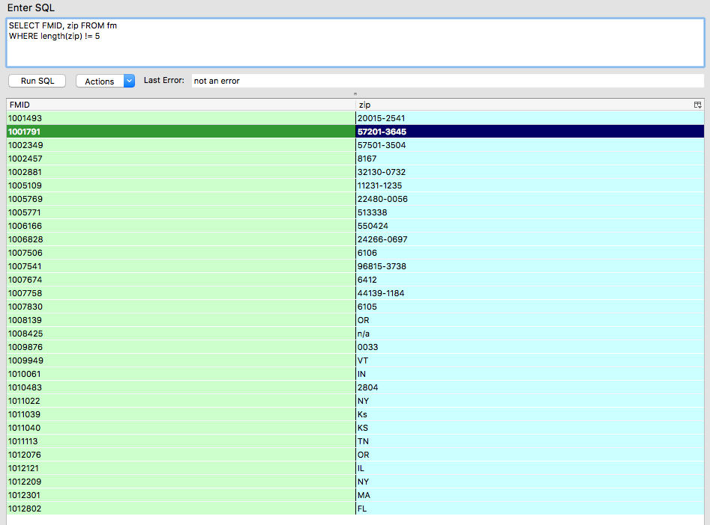
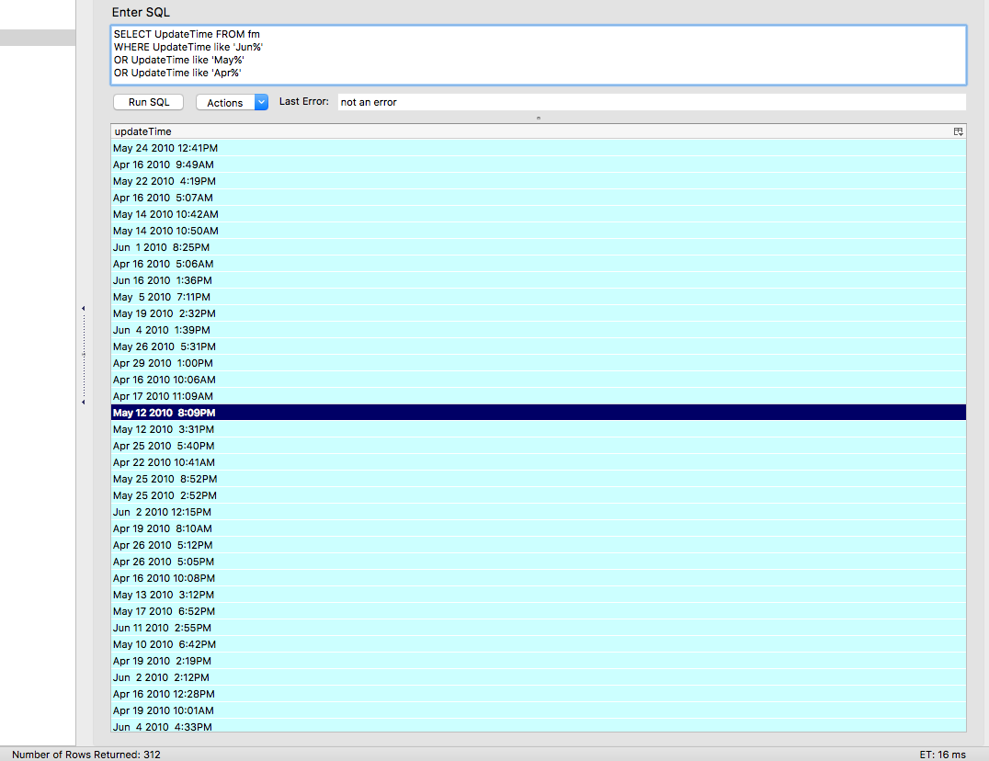
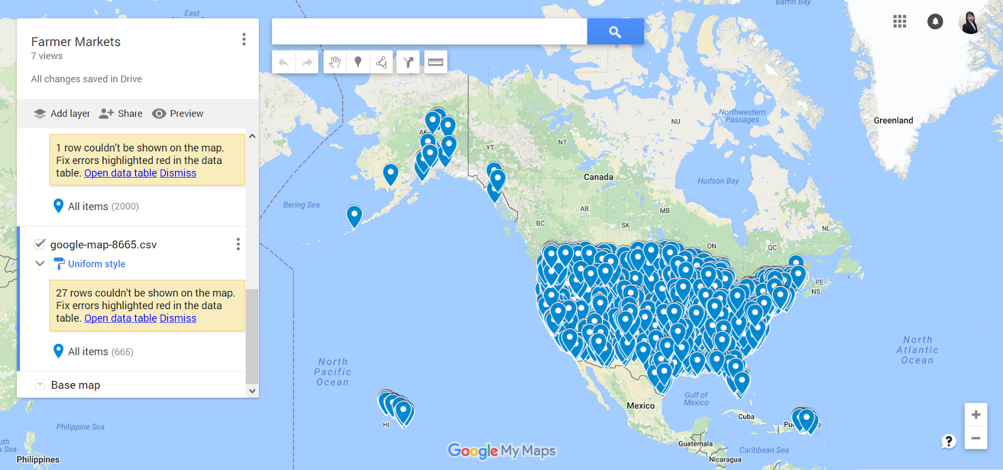
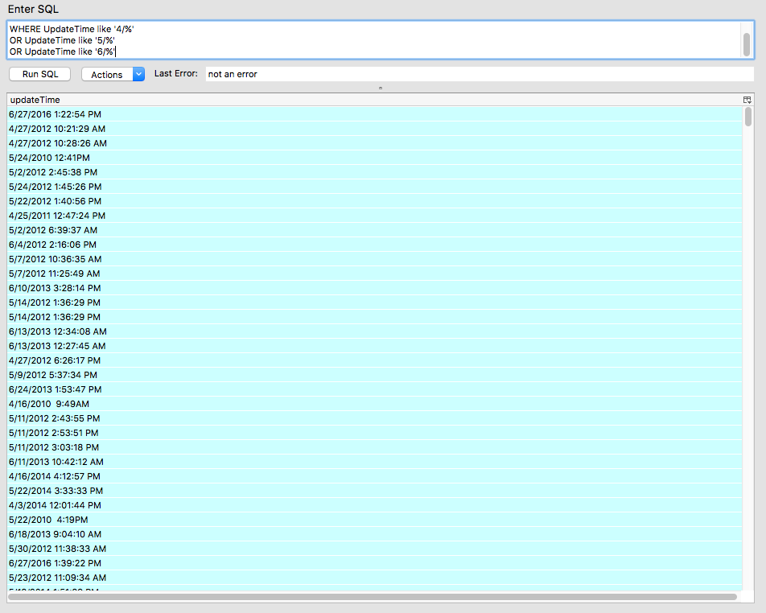
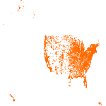
What we’ve done
Check null values for each column
Check duplication for FMID
Check duplication for x and y
Check range of x and y
Check the digits of zip
Point geographic location according to latitude and longitude to find out whether there are abnormal locations
Update date format for UpdateTime column
Notes:
Then we use OpenRefine, SQLite, and other tools to get a more detailed assessment about the dataset and try to fix those problems.
Here are what we’ve done and what we found.
Check null values for each column, here we mainly use SQLite. BTW, when we importing dataset into SQLite, we include all columns and basically set all column as text type. This step, verifies our initial assessment that there are really pretty much null values in dataset. But the good news is, in some columns like FMID, Credit, WIC, no null values.
Check duplication. -No duplication for FMID. Seems that we could us it as primary key.
Here we are curious about, whether there are different records that with exact the same latitude and longitude. We use clustering in OpenRefine and find that yes there are several records that with same x and y but different farm names.
4. -X and y are longitude and latitude, they should be larger than -180 and smaller than 180. No violation but some null values.
5. -We notice that there some zip codes are only four digits while they all should be five digits. Thus we use SQLite to get those are not five-digit.
5. –We use Openrefine and also Google Maps to point the location using x and y values. Left (orange) is from Openrefine, looks good, but not clear enough, so we use Google Maps to get a larger one.
Looks good and seems that there are no point at the ocean.
7. -The format of date and time in this dataset is totally a mess. There are null values, cells with only year, etc. We use SQLite and found that in UpdateTime column, months are represented using letters like Apr for April, Jun for June in some cells. So we use SQLite to transform them into using only digits to represent month.

Slide 4
What to do next
Finish duplication check for each column
Different farms share the same latitude and longitude
Finish the format uniform for date and time
OpenRefine may be a good tool deserving further use
Fill the blank
Create workflow
Notes:
No duplication in FMID, but for the rest of columns, we still need to check it.
Most of what we’ve done is with the help of SQLite, actually we did not really take good use of OpenRefine yet. But when we importing dataset into OpenRefine, we found that for the last column, there are some records has only year value, and OpenRefine automatically add month, date and time for it. For example, 2009, it transformed it as 2009-01-01 00:00:00. It, to some extent uniform the format, but we still need some more discussion to think about whether this kind of transformation is a good idea.
3. Fill the blank: for zip code, we may use address to get the correct zip code.
4. Last step is create workflow

Slide 5
Questions?

